Slide 1


Network Models LAYERS IN THE OSI MODEL: 7 Application Layer 6 Presentation Layer 5 Session Layer 4 Transport Layer 3 Network Layer 2 Data link layer 1 physical Layer
Lecture # 9 and 10
Week# 5
Data Communications and Networking, Fourth Edition, Behrouz A. Forouzan

Slide 2
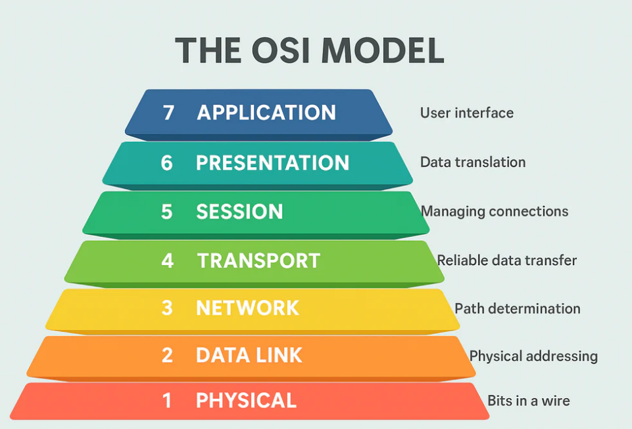
OSI Model

Slide 3
OSI Model
The OSI (Open Systems Interconnection) Model is a conceptual framework that divides the process of network communication into seven layers, where each layer performs a specific function to enable data transfer between devices.
OSI Model breaks network communication into 7 easy steps (layers).
Why Do We Use OSI Model?
To understand networking easily
To design networks
To find and fix network problems
Easy Memory Trick
OSI Model is not software or hardware — it is a way to understand networking
A P S T N D P All People See To Need Data Processing
Important note for students:
OSI Model is not software
OSI Model is not hardware
It is a concept / reference model

Slide 4
7. Application Layer
7. Application Layer (User level)
What it Does
Directly interacts with the user
Provides network services to applications
This is the user-facing layer.
Work:
Takes your message
Prepares it for sending
Examples
Web browser (Chrome)
Email (Gmail)
WhatsApp
Real-Life Example
You opening a website → Application Layer
Protocol | Use
HTTP | Open websites
HTTPS | Secure websites 🔒
FTP | Download/upload files
SMTP | Send email

Slide 5
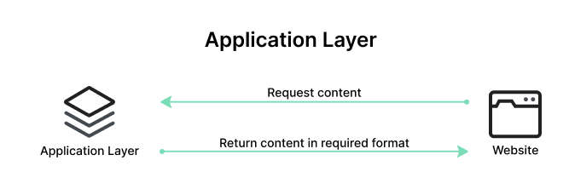
7. Application Layer
Application layer provides network services directly to user applications
and handles request and response between client and server

Slide 6
6. Presentation Layer
Presentation Layer — Translator
1) Translation (Format Conversion)
Computer doesn’t understand:
text, image, video formats directly
Human Form | Machine Form
Text | ASCII / Unicode
Image | JPEG format rules
Video | MP4 encoding
2) Encryption 🔐 (Security)
It hides data so hackers can’t read it.
Example:
Hello → A7#K9@P$%
Only receiver can unlock.
Used in:
HTTPS
Online banking
WhatsApp messages
3) Compression 🗜 (Reduce Size)
Makes data smaller → faster internet
Example:
Image 5MB → 1MB
Video 100MB → 20MB

Slide 7
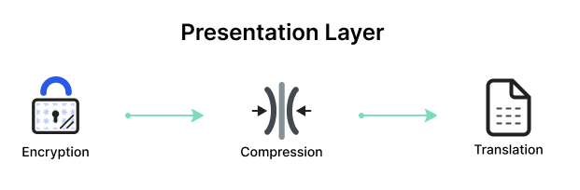
6. Presentation Layer
Protocols / Formats used
SSL / TLS (security)
JPEG, PNG (images)
MP3, MP4 (audio/video)
ASCII / Unicode (text format)
Presentation layer translates, encrypts and
compresses data before transmission.

Slide 8
5. Session Layer
This layer starts, maintains, and ends the communication between two devices
phone call 📞
dial
talk
hang up
That whole conversation control = Session Layer
1) Start Session (Establish connection)
Before data transfer, devices say:
“Are you ready to communicate?”
Like WhatsApp shows online / connected
2) Maintain Session (Keep connection alive)
While chatting:
keeps connection active
if internet drops → pauses
reconnects automatically
3) End Session (Terminate connection)
After work finished:
connection closed
Like ending Zoom meeting or logging out of Gmail

Slide 9
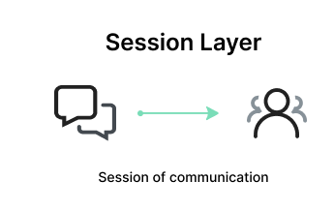
5. Session Layer
Real Life | Session Layer
Call dialing | Session start
Talking | Session active
Hold | Session pause
Hang up | Session end

Slide 10
4. Transport Layer
Transport Layer (Delivery Manager)
This layer makes sure data reaches correctly and completely.
It takes big data and sends it safely.
Imagine Sending a Long Message
You send:
HELLO HOW ARE YOU
Internet cannot send big data at once So Transport Layer breaks it into pieces
HELLO
HOW
ARE
YOU
These pieces are called segments / packets

Slide 11
4. Transport Layer
Main Jobs of Transport Layer
1) Segmentation (Break into parts)
Big data → small packets
2) Error Checking (No missing data)
If packet lost:
Server says:
“Send packet again”
Only missing part resent
3) Flow Control (Control speed)
If receiver slow → sender slows down If receiver fast → sender speeds up

Slide 12
TCP and UDP
TCP Transmission Control Protocol
Data is sent carefully
If data is lost → it is sent again
Data arrives in correct order
Used when data is important
Examples:
File download
Email
Web browsing
Example: Bank transfer must use TCP
UDP User Datagram Protocol
Data is sent very fast
Lost data is ignored
Order does not matter
Used when speed is more important than accuracy
Examples:
Live video streaming
Online games
Video calls
Example: Live cricket match — speed > accuracy

Slide 13
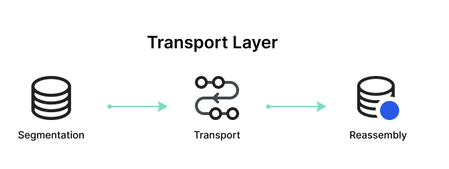
4.Transport Layer
Transport layer divides data into segments and ensures
reliable delivery using TCP or fast delivery using UDP

Slide 14
3. Network Layer
Network Layer— Route Finder (GPS of Internet)
This layer decides where the data should go It uses the IP address to find the destination.
Transport layer made packets Now Network layer asks:
“Which path should I take to reach the other computer?”
Like Google Maps choosing route
Examples
IP addressing
Routers
Easy Example
Google Maps finding the best route.

Slide 15
3. Network Layer
Example
You open website:
www.youtube.com
First it becomes an IP address:
142.250.183.206
1) Logical Addressing (IP Address)
Every device on internet has unique number
2) Routing (Finding best path)
Routing is the process of selecting the optimal path for data transmission between networks
There are many paths in internet
Network layer chooses shortest/fastest path
Routers work on this layer
Portocol:
IP (Internet Protocol)
That’s why we call it:
TCP/IP networking
Network layer assigns IP address and routes packets from source to destination.

Slide 16
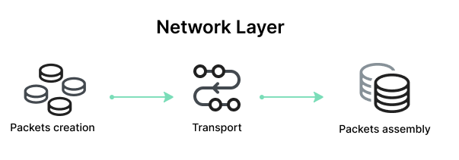
3. Network Layer

Slide 17
2. Data Link Layer
Data Link Layer — Local Delivery (Same Network)
This layer delivers data inside your local network (WiFi / LAN)
Network Layer uses IP address (global address) Data Link Layer uses MAC address (device physical address)
What is MAC Address?
Every device has a unique hardware number
IP Address = 192.168.1.5 (changeable)
MAC Address = A8:5E:45:2B:91:AC (permanent)
Framing is the process of converting packets into small structured units called frames before sending them on the local network.
Eaxmple:
You want to send:
HELLO
[From: A8:5E:45:2B:91:AC To: B4:7C:9A:11:00:2F Data: HELLO Check: OK]
This complete structure = Frame
Data Link layer provides local delivery of frames using MAC address within the same network.

Slide 18
2. Data Link Layer
Major Functions of Data Link Layer
1. Framing The data is divided into small pieces called frames so it can be sent through the network easily.
2. Physical Addressing (MAC Address) Each device has a MAC address, and the Data Link Layer uses it to send data to the correct device on the same network.
3. Error Detection and Correction It checks the data for errors. If there is a mistake, the data is sent again.
4. Flow Control It controls the speed of data sending so the receiving device can handle the data properly.
5. Access Control It decides which device can use the network cable at a particular time to send data.

Slide 19
2. Data Link Layer
Feature | MAC Address | IP Address
Full Name | Media Access Control | Internet Protocol
Layer | Data Link Layer (Layer 2) | Network Layer (Layer 3)
Type | Physical / Hardware address | Logical / Software address
Changeable? | No (fixed in device) | Yes (changes with network)
Purpose | Identify device inside same network | Identify device on internet
Example | A8:5E:45:2B:91:AC | 192.168.1.5
Scope | Local (LAN/WiFi) | Global (Internet)
Uses
Home Wifi
Office LAN
Bluetooth
Ethernet
Real Life | Network
City name | IP address
House number | MAC address

Slide 20
Difference between MAC and LLC Sublayers
Feature | MAC (Medium Access Control) | LLC (Logical Link Control)
Purpose | Controls access to physical medium | Manages communication & services
Address | Uses MAC address | Uses logical addressing info
Responsibility | Who can send data | How data is delivered
Error control | No | Yes (flow & error control)
Position | Lower part of Data Link Layer | Upper part of Data Link Layer
Example | Ethernet hardware communication | Interface with Network Layer
MAC decides who sends, LLC decides how it is managed

Slide 21
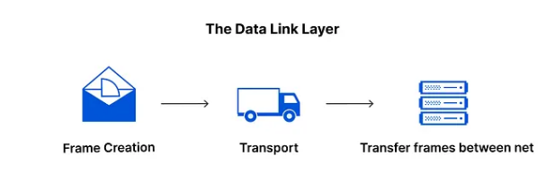
2. Data Link Layer

Slide 22
1. Physical Layer
Physical Layer — Signals & Hardware
This layer actually moves the data physically No logic, no address — only electrical / light / radio signals
Medium/Devices | Example
Cable | Ethernet wire
Fiber | Internet fiber cable
Wireless | WiFi signals
Bluetooth | Air waves
Example
You send photo to friend in same WiFi
Application → you click send
Other layers prepare data
Physical layer transmits as signals

Slide 23
1. Physical Layer
What Physical Layer Handles
Voltage levels
Signals
Bits (0 & 1)
Connectors
Network cables
Devices working here:
Hub
Repeater
Cables
Antenna

Slide 24
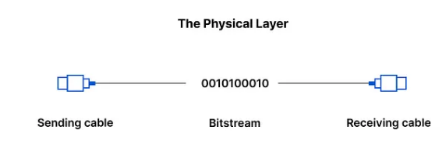
1. Physical Layer
Sending Cable 📤
Your computer sends electrical signals into the cable
Bitstream (0 & 1)
Data travels as:
Electricity (Ethernet)
light (fiber)
radio waves (WiFi)
Receiving Cable 📥
Other computer receives signals and rebuilds data

Slide 25
THANK YOU
You can Find me:
mehakrana.CS@tuf.edu.pk

